Slide 1
Polarization Game over Social Network
Xilin Zhang
PhD Candidate
Advisors: Dr. Zeynep Ertem, Dr. Emrah Akyol
Department of System Science and Industrial Engineering
State University of New York at Binghamton

Slide 2
Agenda
Modeling Polarization Game on Social Network
Constraint Game v.s. Zero Sum Game
Player’s behavior
Constraint Game
Zero Sum Game
Social Implementation

Slide 3
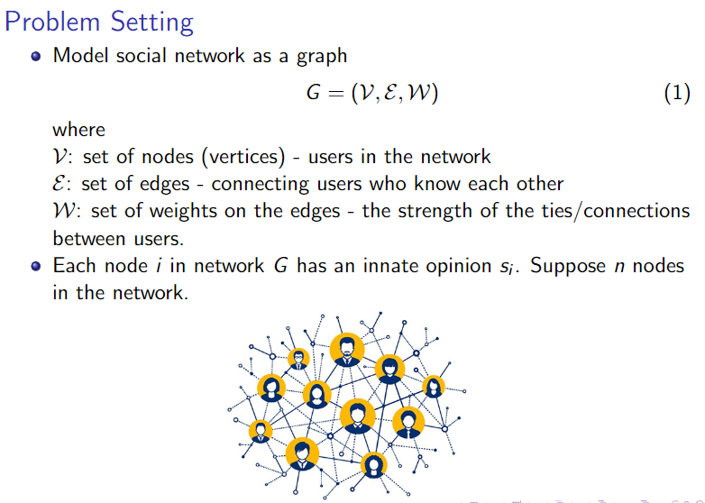
Modeling Network

Slide 4
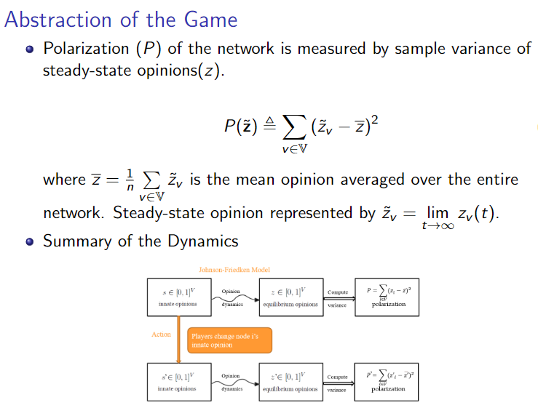
Polarization Game

Slide 5
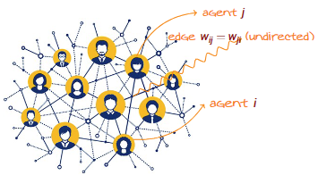


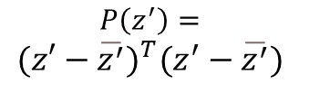
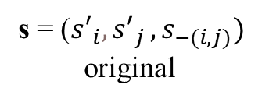
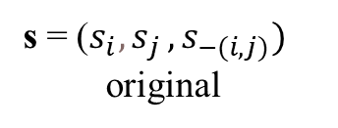
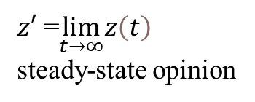
Network Dynamic Summary
s = ($s_{i}{, s}_{j},s_{−(i,j)})$
original
Maximizer[$ⅈ^{A}{, s}_{ⅈ^{A}}] \text{[}ⅈ^{A}{, s′}_{ⅈ^{A}}]$
Minimizer[$ⅈ^{B}{, s}_{ⅈ^{B}}] \text{ [}{ ⅈ}^{B}{, s′}_{ⅈ^{B}}]$
s = (${s′}_{i}{, s′}_{j},s_{−(i,j)})$
original
Opinion
dynamics
$z′$ =$\lim_{t→∞}z\left(t\right)$
steady-state opinion
Compute
variance
$$P\left(z^{′}\right)=$$
$$(z′−\overline{z^{′}})^{T}(z^{′}−\overline{z^{′}})$$
polarization

Slide 6
Constraint Game vs. Zero Sum Game

Slide 7
Constraint Game
Behavior of Players

Slide 8
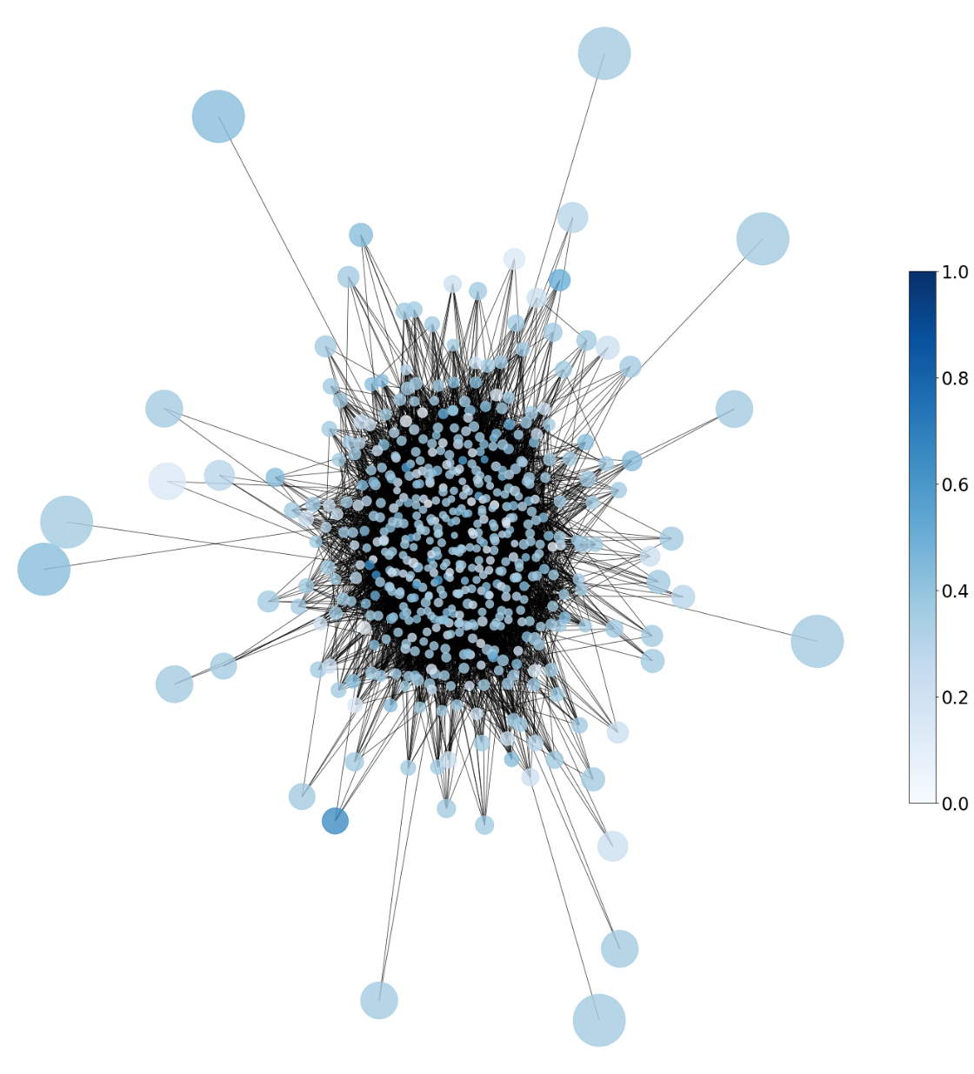
Reddit – Constraint Game
481
Max
Min
Min:
50
Innate opinion
Max:
284
245

Slide 9
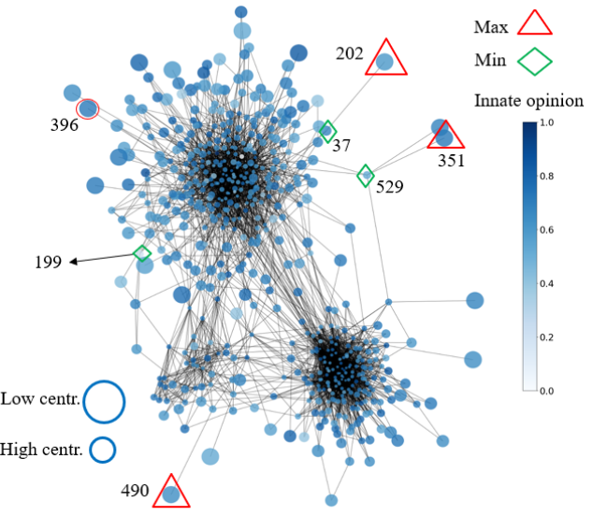
Twitter – Constraint Game

Slide 10
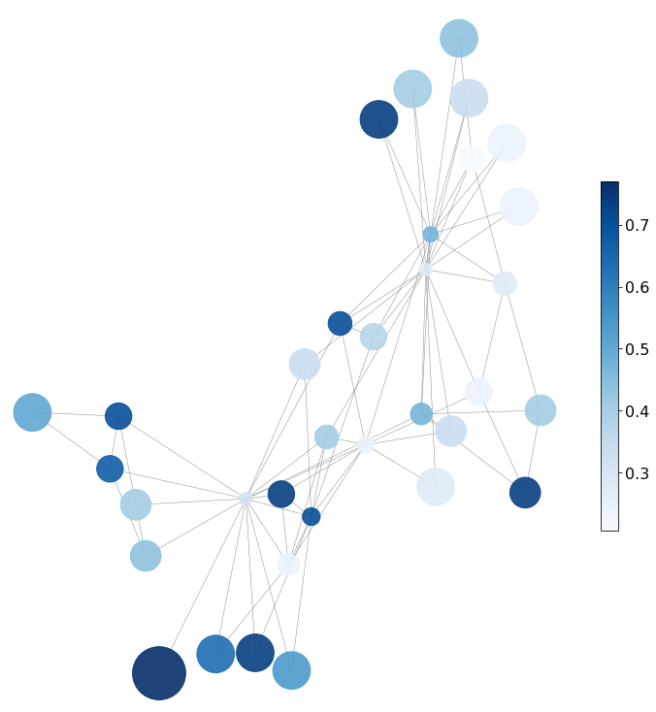
Karate - Constraint Game
Low centr.
Max
Min
High centr.
29
Innate Opinion
6
16
11

Slide 11
Constraint Game – Karate NE
Low centr.
Low centr.
Max
Max
Min
High centr.
Min
High centr.
29
Innate Opinion
29
Innate Opinion
Change 29’s opinion to 0.5
33
16
6
6
16
11
11

Slide 12
Zero-Sum Game
Behavior of Players

Slide 13
Karate - Zero Sum NEs
Low centr.
High centr.
Innate Opinion
16
6
11
NE 1:
Max
Min
NE 2:
Max
Min

Slide 14
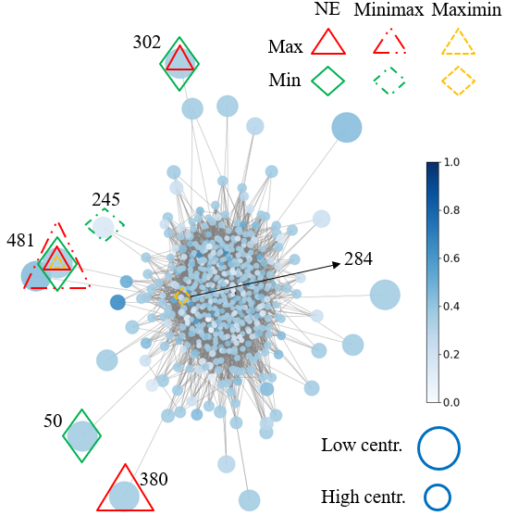
Reddit - Zero Sum NEs

Slide 15
Twitter - Zero Sum NEs

Slide 16

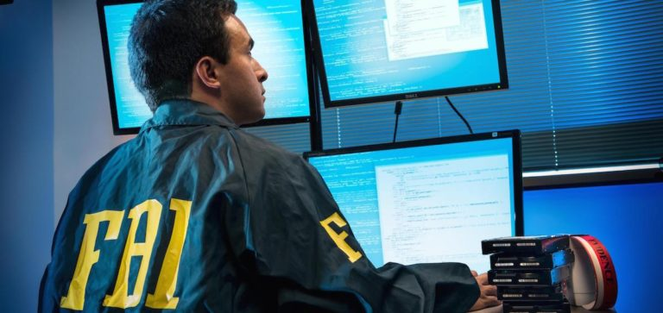

Social Implementation

